Slide 1
Guidelines for final projects
You must choose your teammate and your project (fill out the online survey) by 5 pm, May 20
You must submit your report and code by June 16th
Dr. Xiran Cai
caixr@shanghaitech.edu.cn
SIST Building 3-438

Slide 2
Scores
Build your team: 2-3 persons per team
Final Project: 40 points
Bonus: subjects having less teams working on have extra bonus (Na-Ni)*4 points (12 points maximum).
Ni: No. of teams selecting project i
Na: Total No. of teams/4

Slide 3
Evaluation for final project
How well your method works. 50%
How clear and convincible is your presentation. 25%
How clear and complete is your report writing. 25%
• Introduction: include your motivation, background of this problem, related work of the method you adopted.
• Method and Results: clearly state each step and the outcome, use equations, flowchart or figures to help with the explanation when necessary.
• Conclusion and Discussion: is your result perfect, why? If not, why is that and how to improve?
• Please use the provided template for unifying report format. (in the folder named “Template”)
• A good example for report writing is provided (see Example-report.pdf).

Slide 4


Project 1: Image editing
Background:
Seam carving is an algorithm for content-aware image resizing .
It functions by establishing a number of seams (paths of least importance) in an image and automatically removes seams to reduce image size or inserts seams to extend it.
Goal:
Expand the background image without altering the relative proportions of individuals using seam carving.
Get the foreground from another image using image matting and integrate it into the expanded background image.

Slide 5

Project 2: Handwritten Text Recognition
Background: Text recognition, also known as Optical Character Recognition (OCR), is the process of converting printed or handwritten text into machine-readable format.
Goal: In this project, you will implement text recognition on handwritten text.
Expected result:
Dear Mrs Green
Im so glad to hear …
of you to show …
(No requirement for punctuations (like "," "\&" "-").)
Notes:
IoU = 真实值与预测值的交集 / 真实值与预测值的并集

Slide 6
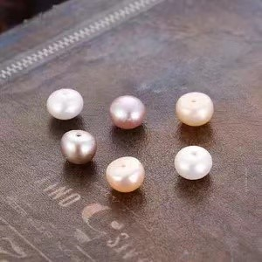
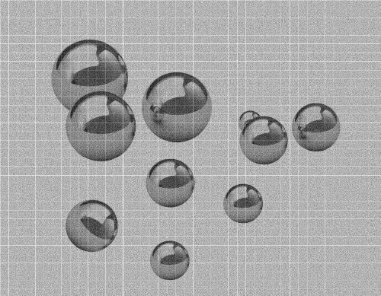
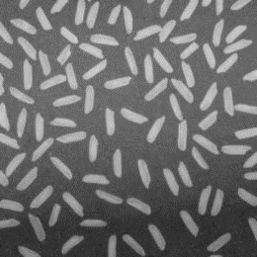


Project 3: Segmentation and Counting
Background: Image segmentation refers to the process of partitioning an image into multiple segments or regions, each of which corresponds to a different object or area within the image.
Goal: In this project, you will implement particle segmentation and counting with different difficulty levels.
Notes:
IoU = 真实值与预测值的交集 / 真实值与预测值的并集

Slide 7
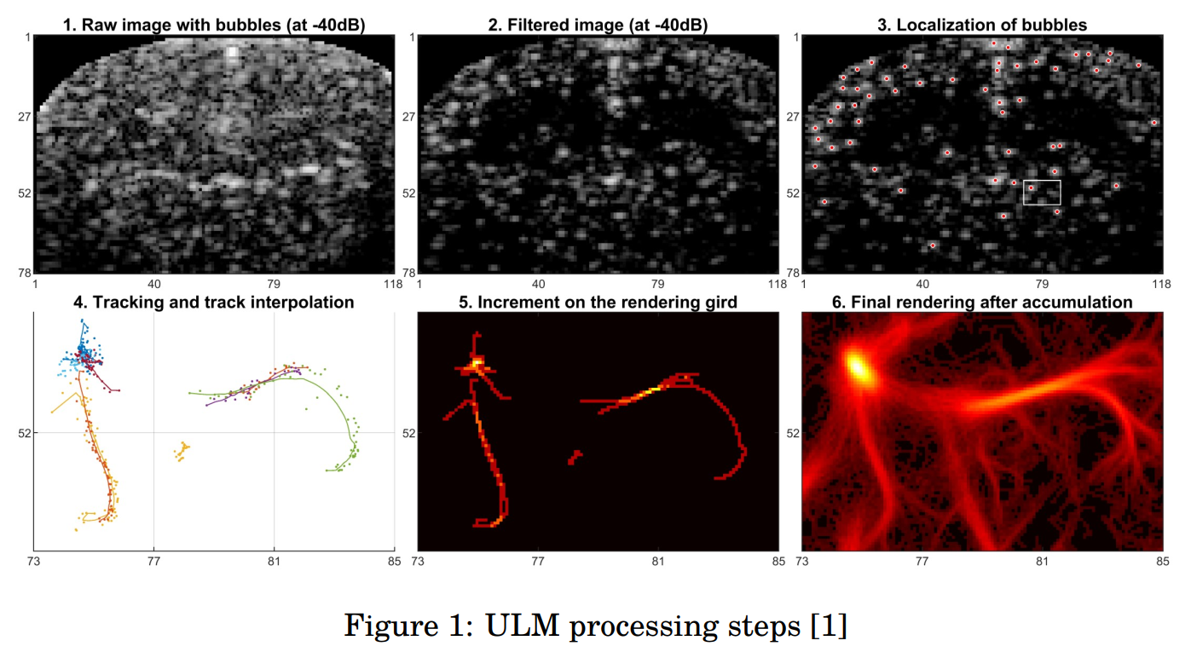
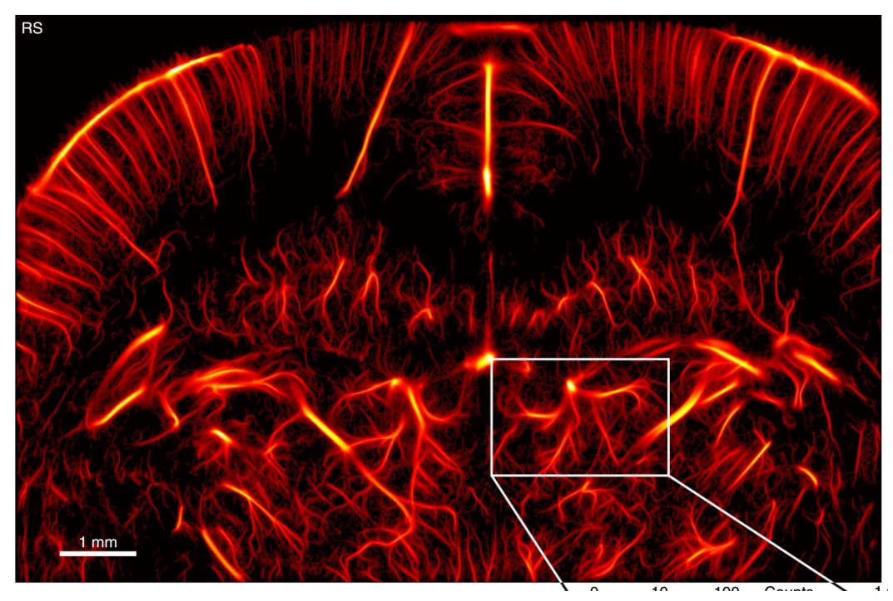
Project 4: Time Efficient Ultrasound Localization Microscopy
Background: Ultrasound localization microscopy (ULM) breaks the diffraction limit resolution which improve the spatial resolution by 10 times in ultrasound imaging. However, the images need to be acquired at a very high frame rate imposing high requirement to the ultrasound hardware. In this project, we will implement an interpolation method that will ease this requirement on high frame rate.
Goal: Implement the radial basis function 2D interpolation to upsample the acquired ultrasound dataset for establishing the Time Efficient Ultrasound Localization Microscopy method.

Slide 8
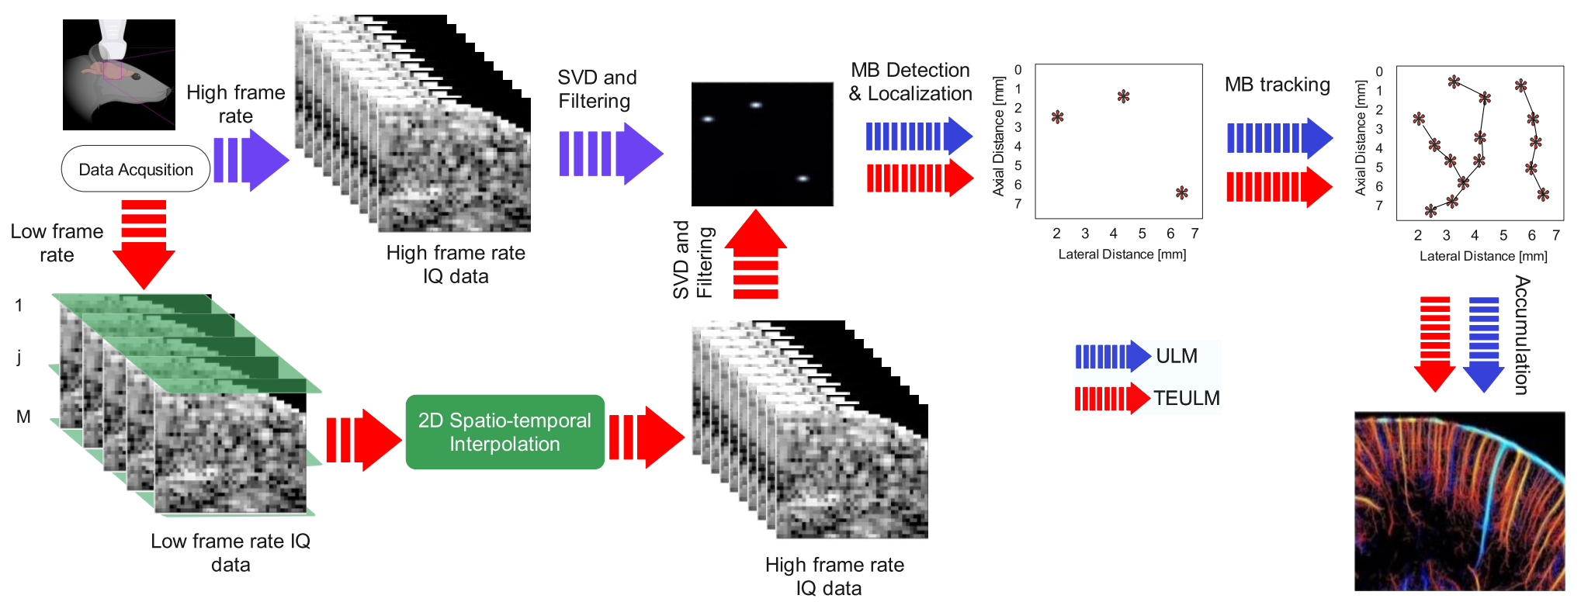
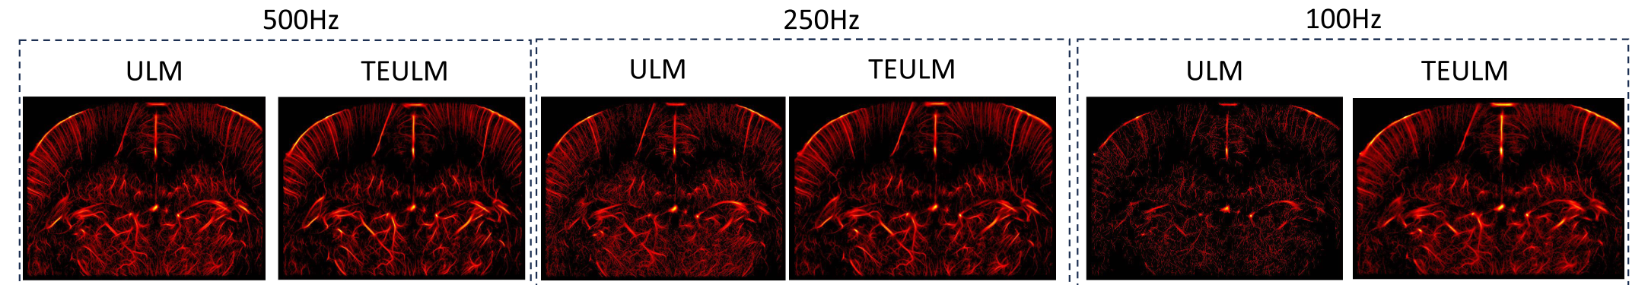
Project 4: Time Efficient Ultrasound Localization Microscopy

